Slide 1





23/08/2024
FINSHARK
Nazif Selimi Dardan Osmani

Slide 2


Agenda
1
Introduction
2
Problem Statement
3
System Architecture
4
Key Features
5
Limitations

Slide 3

Introduction
1
Project Overview
A platform for managing stock portfolios and conducting financial analysis.
2
Purpose
To simplify portfolio management and provide real-time stock data and insights for investors.

Slide 4
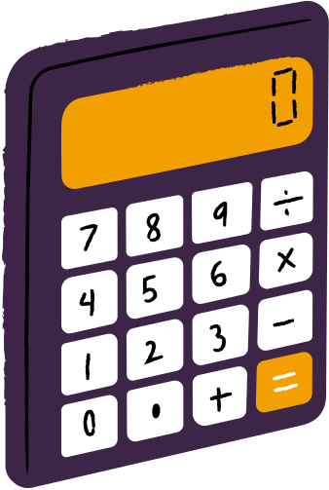

Problem Statement
Challenges: Managing diverse stock portfolios is difficult with existing tools, which are either too complex or lack advanced features.
Solution: Create a platform that is user-friendly but also powerful enough for in-depth financial analysis.

Slide 5


System Architecture
Service-Oriented Architecture: Explanation of the modular structure (models, repositories, services, controllers).
Data Flow: Backend provides API endpoints to the frontend; real-time data fetched from external API if missing in the database.

Slide 6


Key Features
Real-Time Data
Portfolio Management
Financial Analysis

Slide 7

Limitations
No User Roles: All users have the same level of access.
Lack of Continuous Updates: Real-time updates on stock prices are not yet implemented.
Basic Financial Analysis: Advanced tools like predictive models are not available.

Slide 8

Thank You!
Questions?

